Slide 1
Introduction to Data Visualization using R and ggplot
Joshua Falk

Slide 2
Introduction
Learning Objectives:
Understand the broader landscape of data visualization
Understand the importance of plotting your data
Understand how ggplot decomposes graphs into combinable components
Produce scatter plots, line graphs, bar graphs
Customize plots

Slide 3
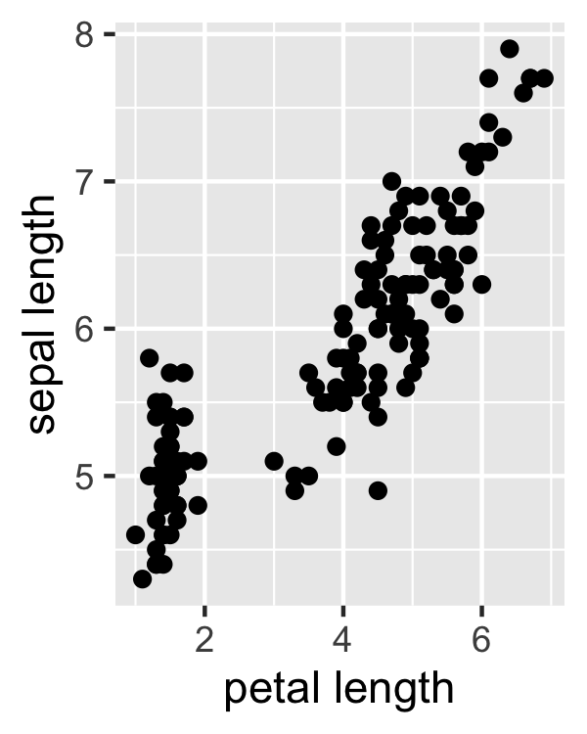
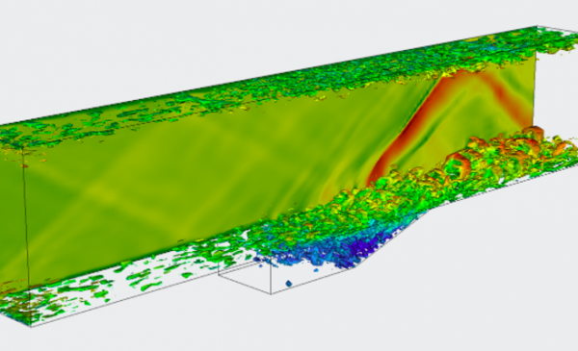
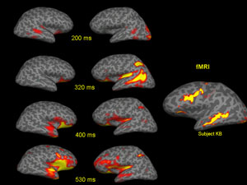
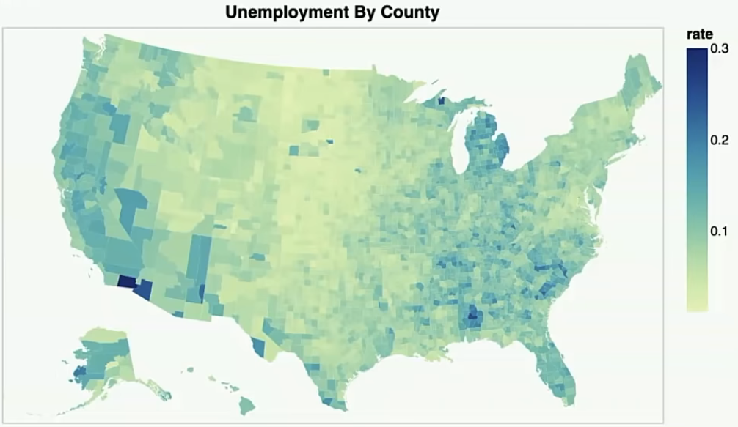
Data visualization
Graphical representation of data

Slide 4
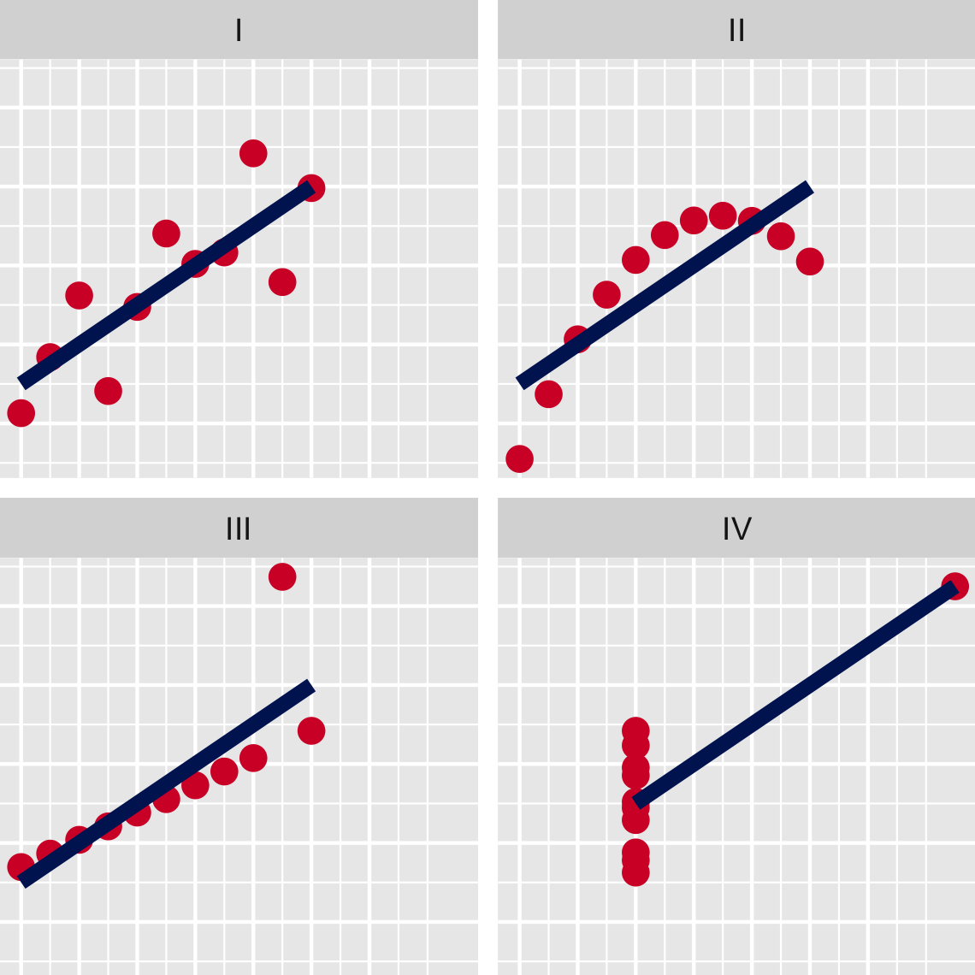
Why plot?

Slide 5
Grammar of Graphics
A way of breaking graphs into reusable and combinable components
Data
Transformations
Marks
Encoding
Scale
Guides

Slide 6
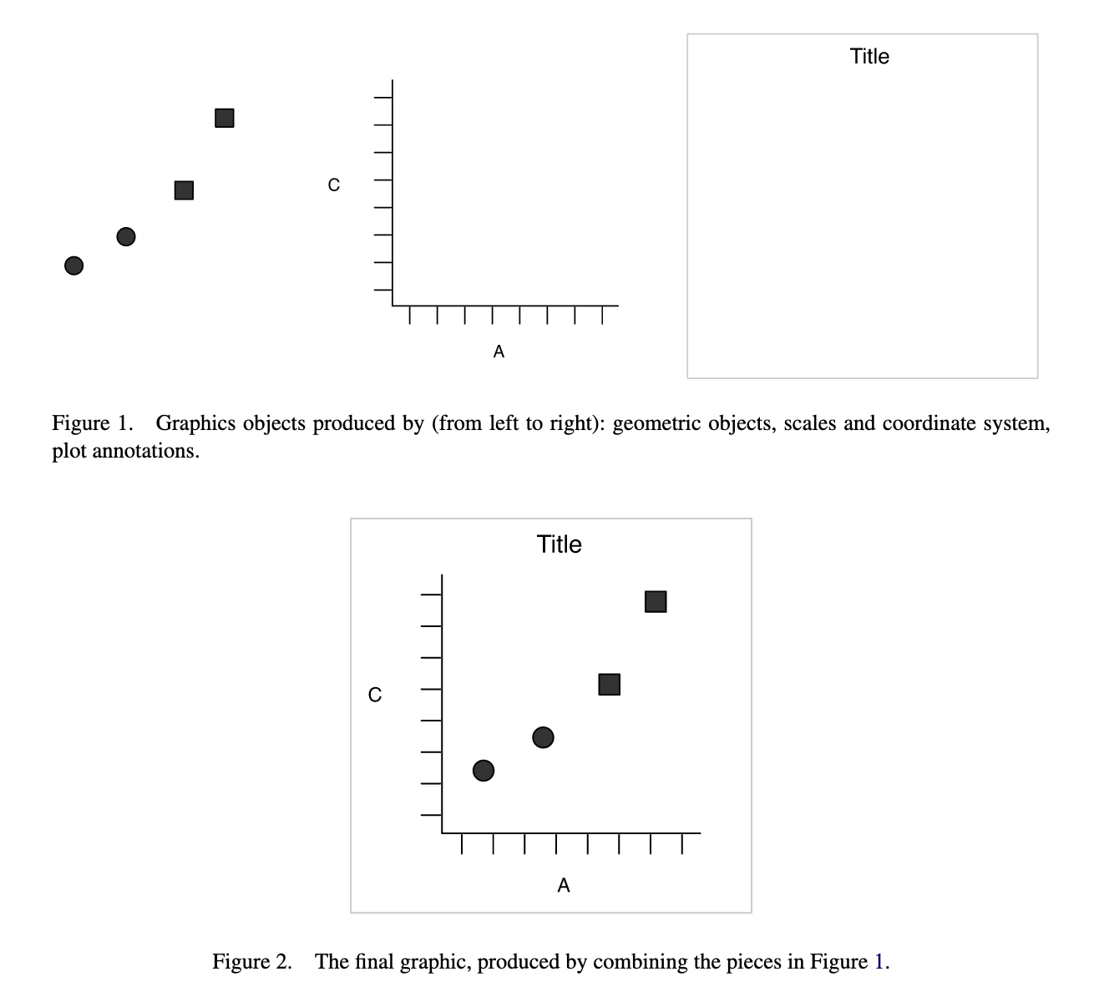
Grammar of Graphics

Slide 7
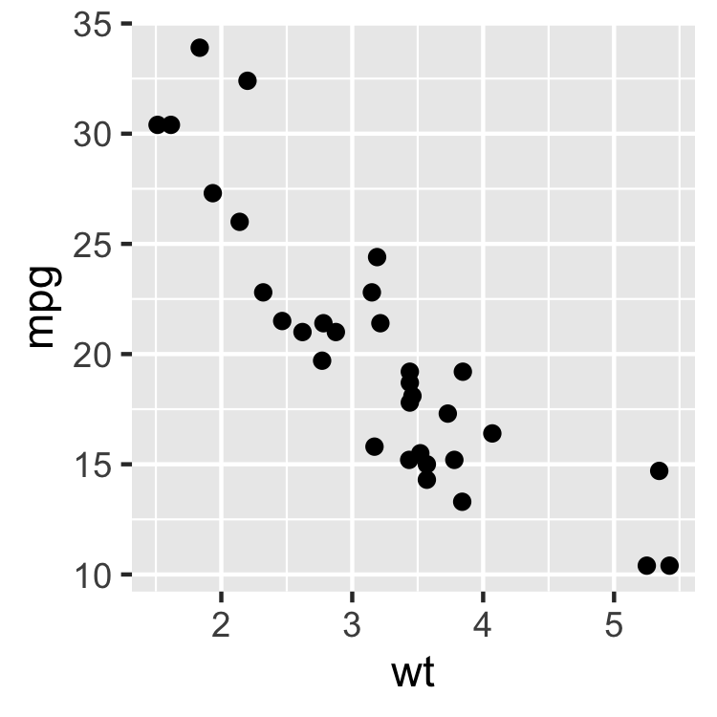
Scatter plot

Slide 8
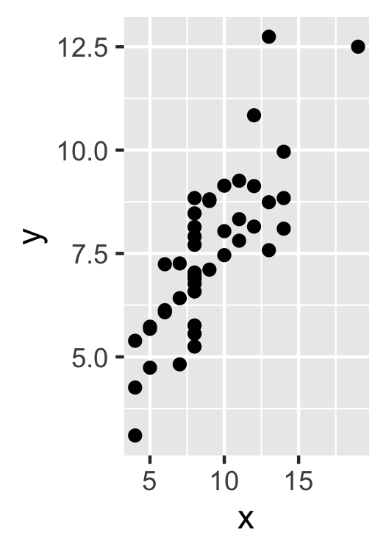
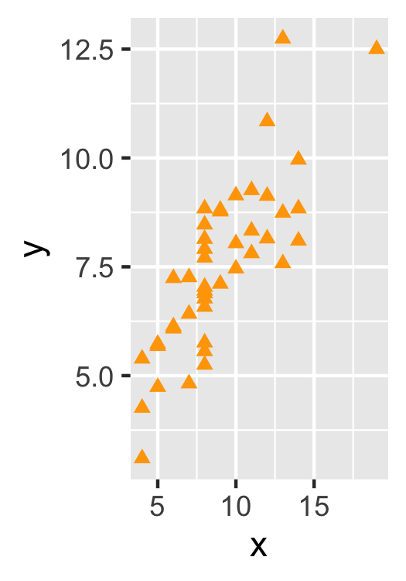
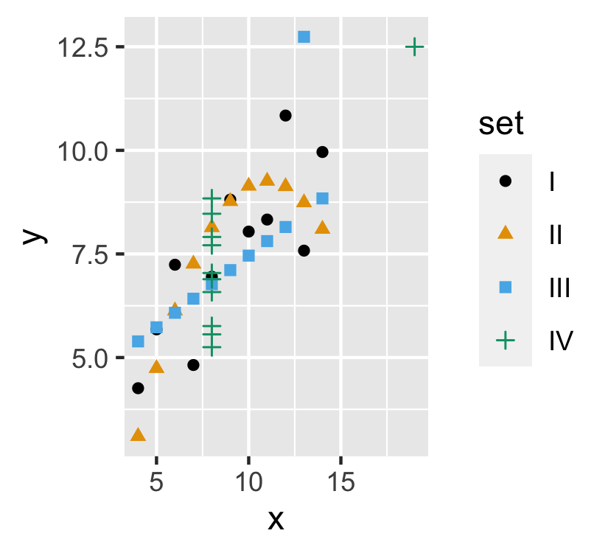
Exercises

Slide 9
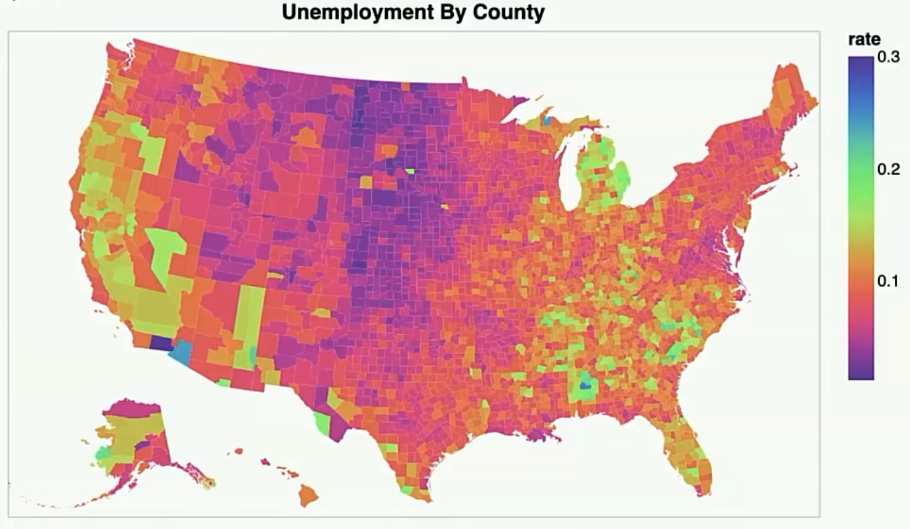
Color Hue / Color Value

Slide 10
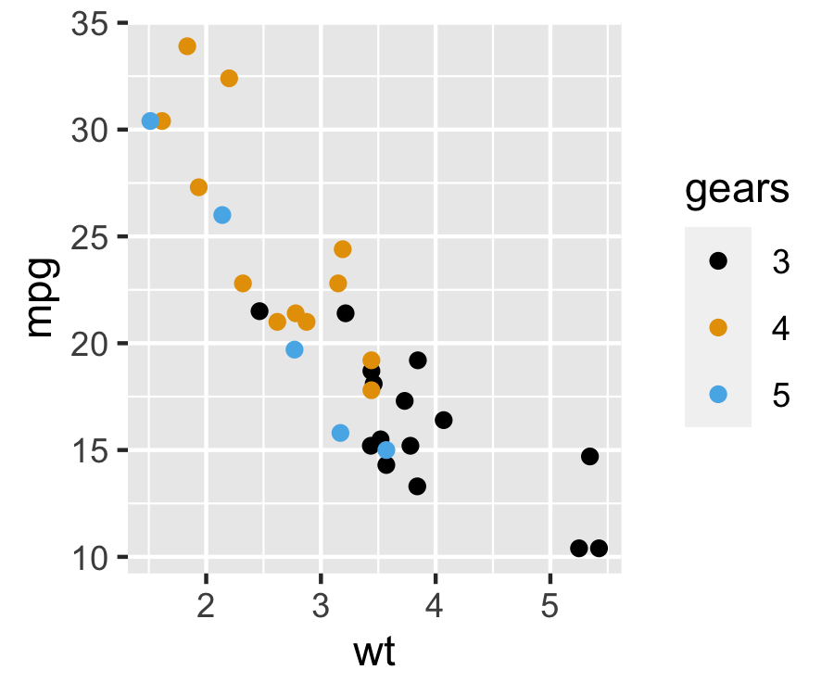
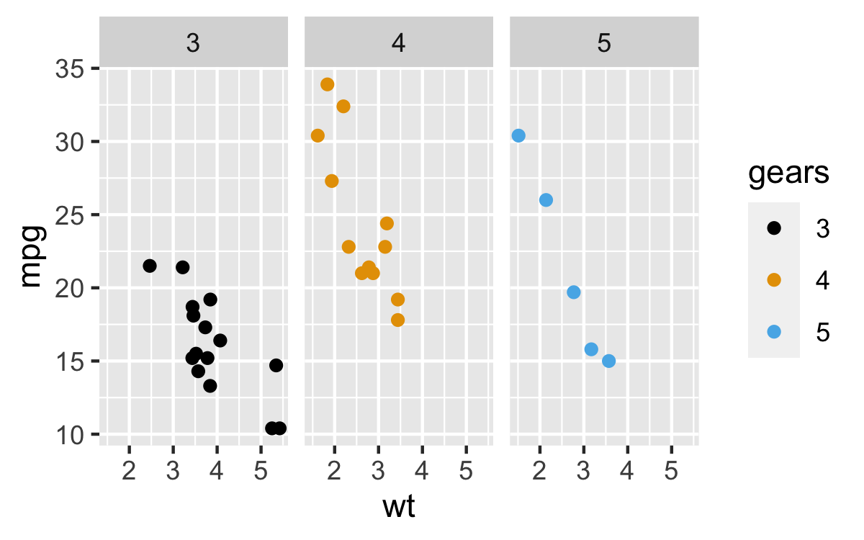
Faceting

Slide 11
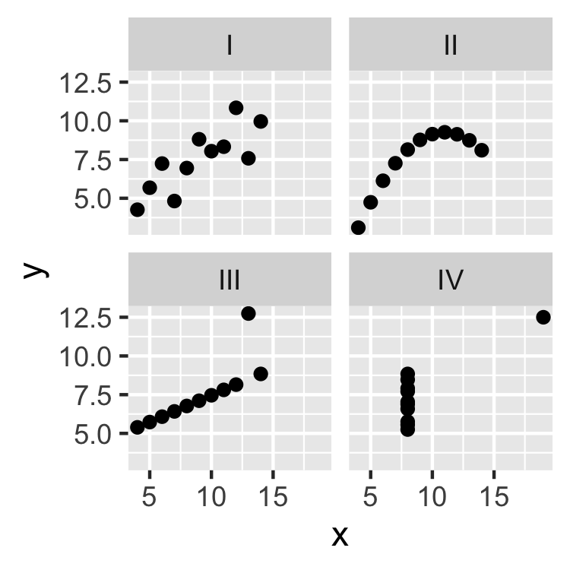
Exercise

Slide 12
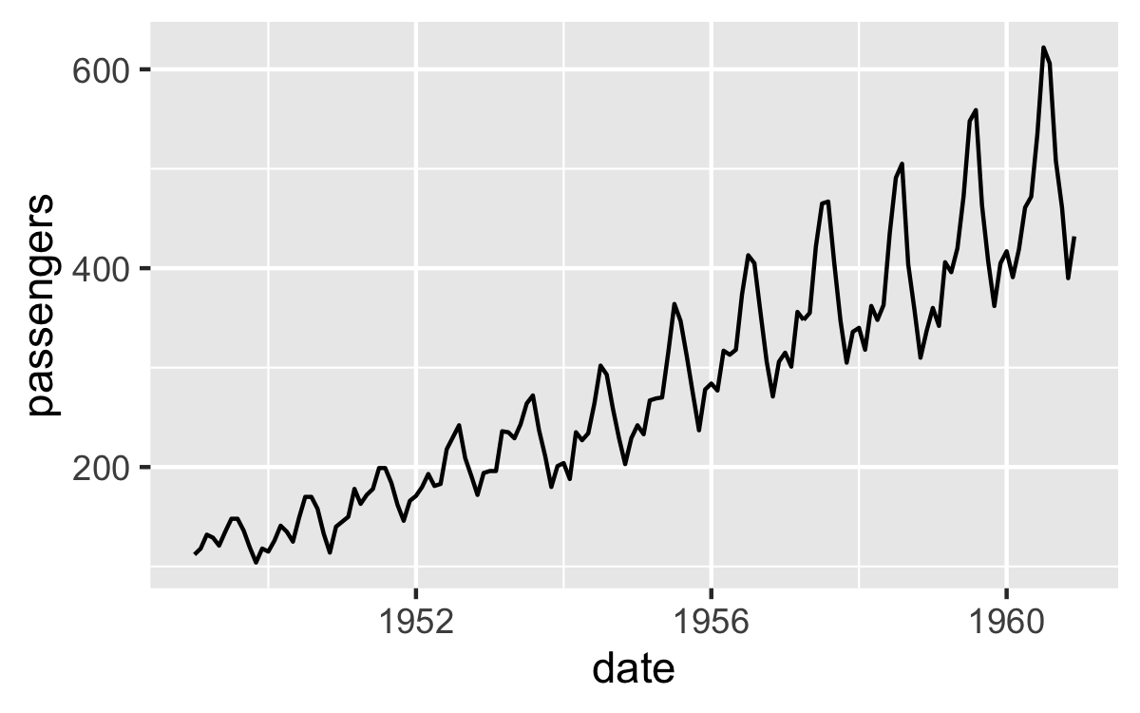
Line graph

Slide 13
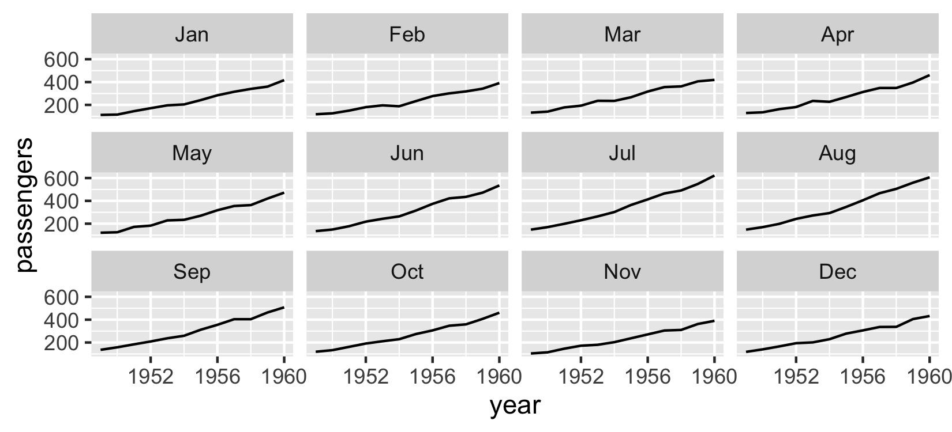
Exercise

Slide 14
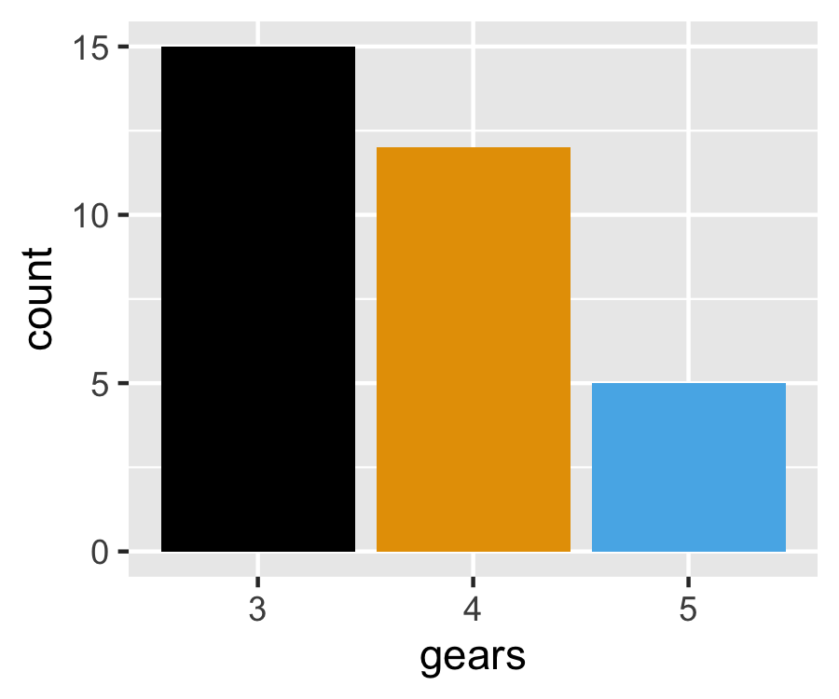
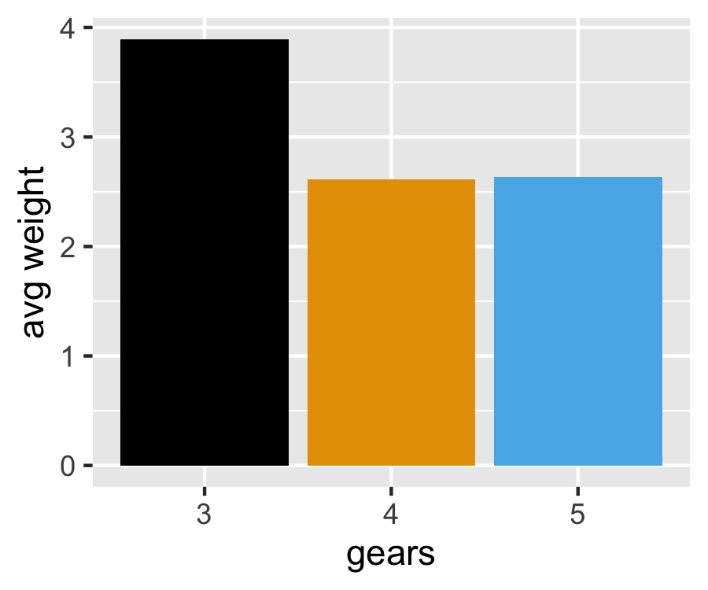
Bar graph

Slide 15
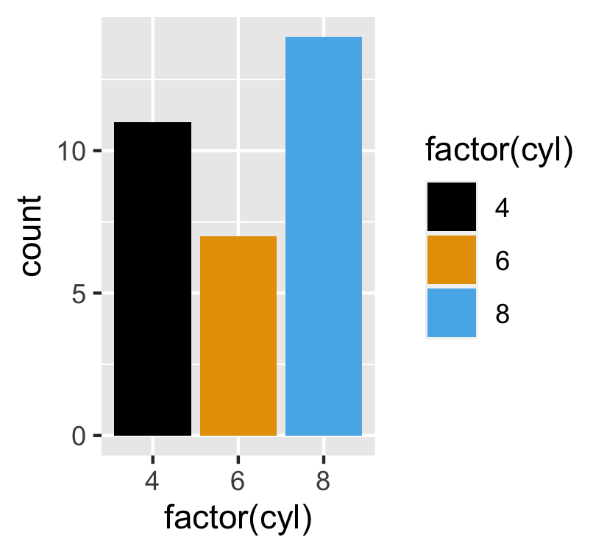
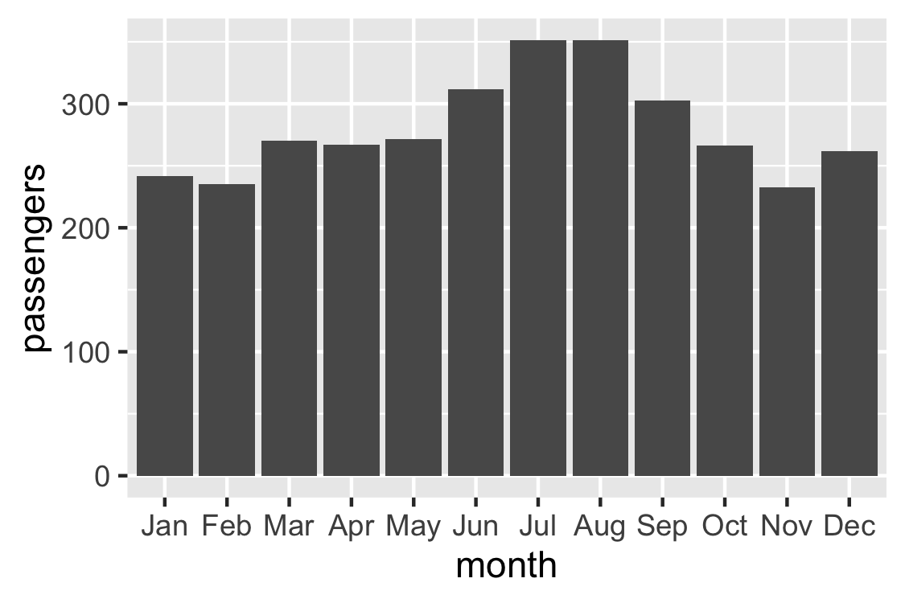
Exercise

Slide 16
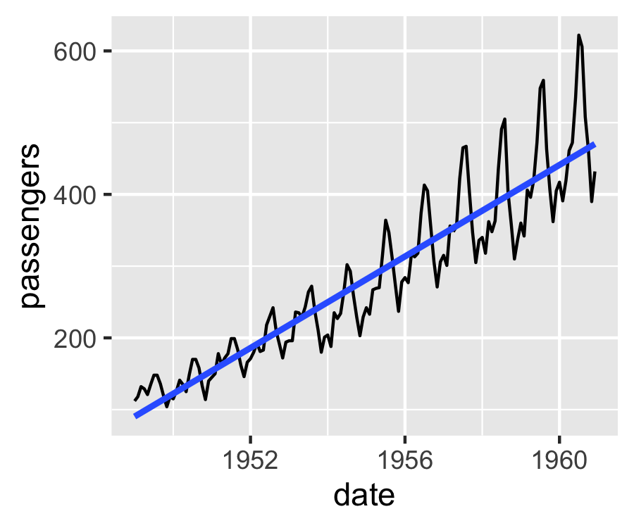
Regression Lines

Slide 17
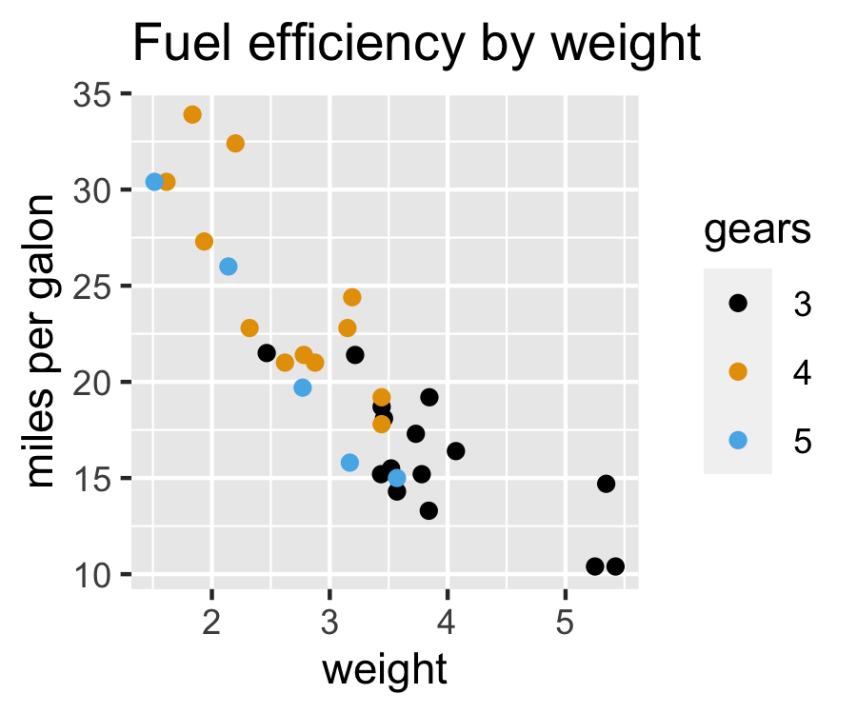
Labels and Titles

Slide 18
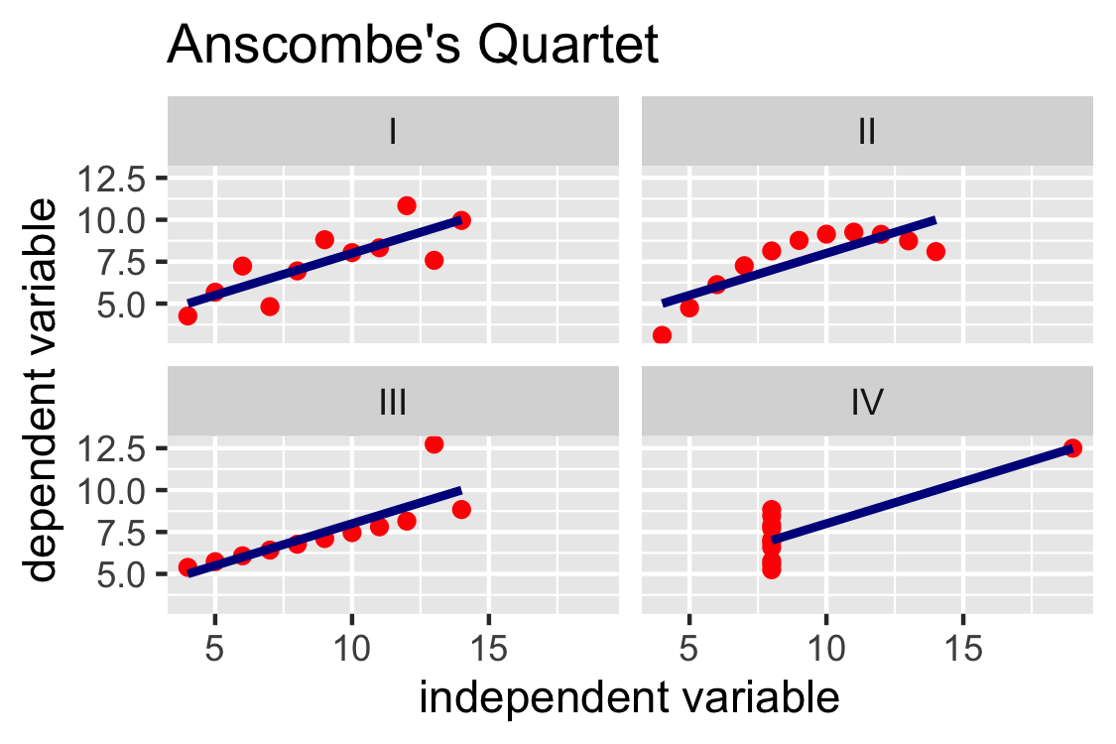
Exercise
red or #D50032
darkblue or #001E62

Slide 19

Thank you for your attention!
Please provide feedback through 1-minute survey
Use QR code on the right or URL from Zoom Chat
Spread the word
https://acer.uic.edu/about-acer/news-events/
Learn more:
Documentation: ggplot2.tidyverse.org
Textbook (free): ggplot2-book.org
Come to weekly office hours (use the link above)
Any further questions, please contact us
email: acer@uic.edu
web: acer.uic.edu

Slide 20
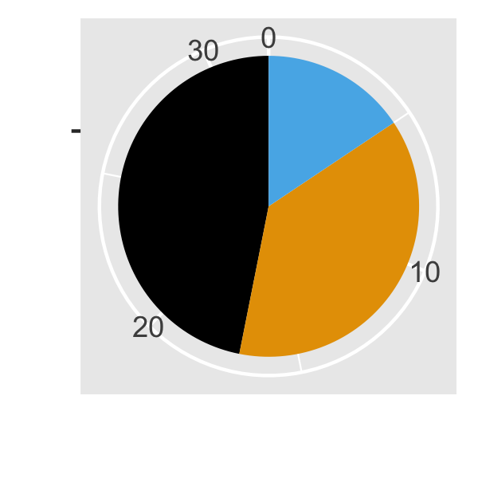
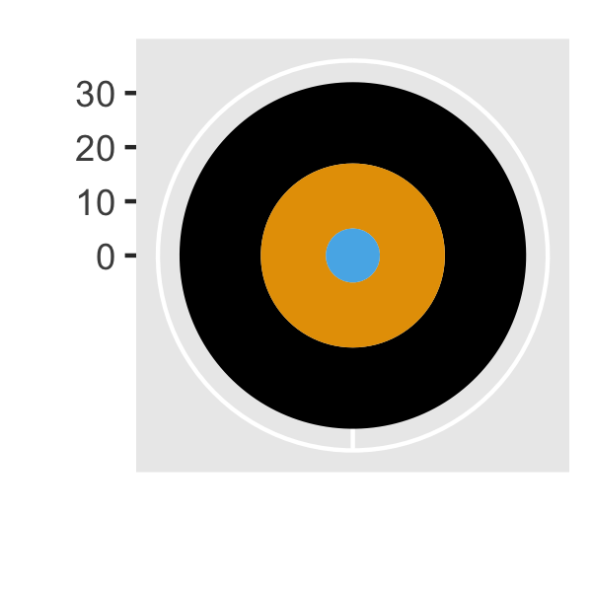
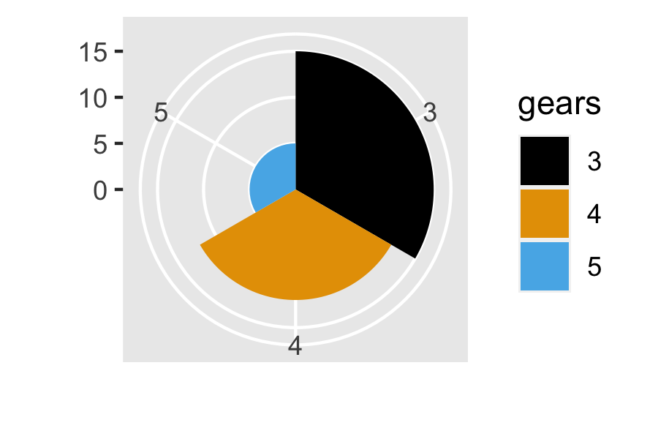
Pie chart and more

Slide 21
Levels of Organization
Position | N | O | Q
Size | N | O | Q
Color Value | N | O | Q
Texture | N | O
Color Hue | N
Orientation | N
Shape | N
Nominal
(categorical, factor)
e.g. car brand
Ordinal
e.g. rating scale, bucketed age
Quantitative
e.g. weight, mpg, number unemployed

